Slide 1
Jr. research presentation
By Elizabeth Sellers

Slide 2
What are you doing?
My project idea is to automatically detect dark matter by analyzing gamma ray patterns.
Dark matter particles probably decay into photons that are visible in the gamma part of the electromagnetic spectrum. Areas of high interactions among particles would have to be areas of high density, like near a black hole. Therefore, I would analyze gamma ray data near a black hole, compare it to gamma ray data not near a black hole, and look for patterns that indicate a significant decay.

Slide 3
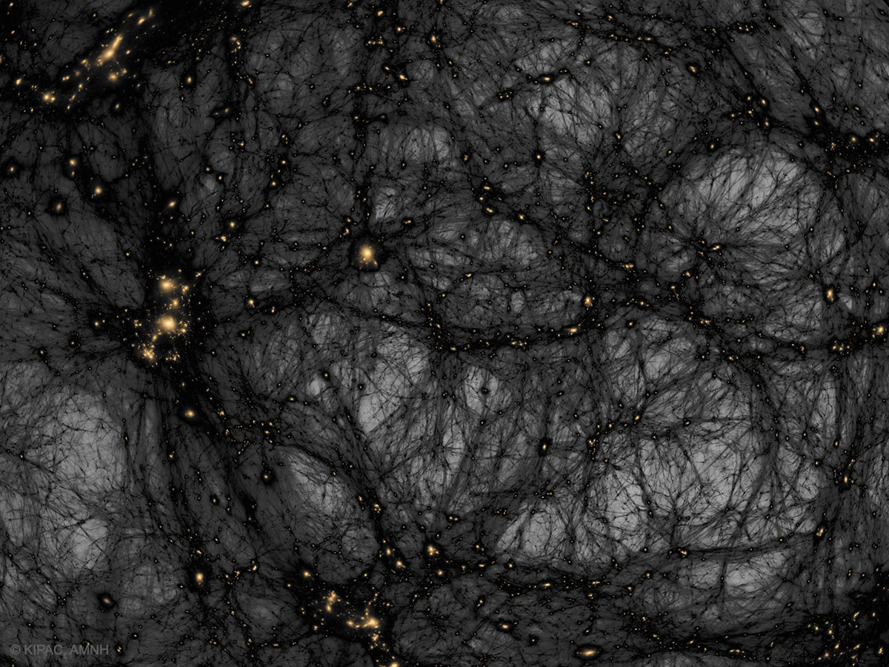
Who cares?
About 27% of the universe is made up of dark matter. Stars and galaxies are about 5%. Having a concrete idea of where it is, therefore, is imperative to mapping and understanding the universe.
Image: https://apod.nasa.gov/apod/ap171031.html

Slide 4
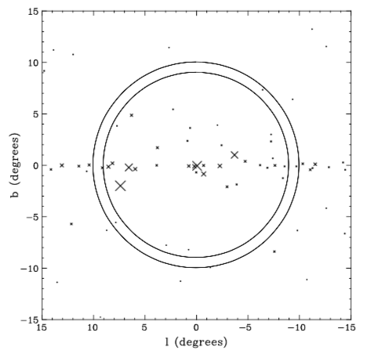
What is known?
Dark matter is, for all intents and purposes, invisible. The indirect detection of dark matter through the detection of its annihilation is, with current technology, the only way to detect it.
There have been multiple experiments to find concrete data for dark matter decay; almost every one has either been inconclusive or found nothing.
Image: https://www.sciencedirect.com/science/article/pii/S0370269311001742

Slide 5
What is new?
Previous searches for dark matter annihilation have only looked in one area, like near a single black hole. I want to look at gamma ray emission data from multiple areas and looks for a pattern based on a number of different factors; amount of gamma ray emission (of course), location, proximity to a black hole or other dense space object, and what else is in the area based on what we know. This list will most definitely expand as I work to find patterns.

Slide 6
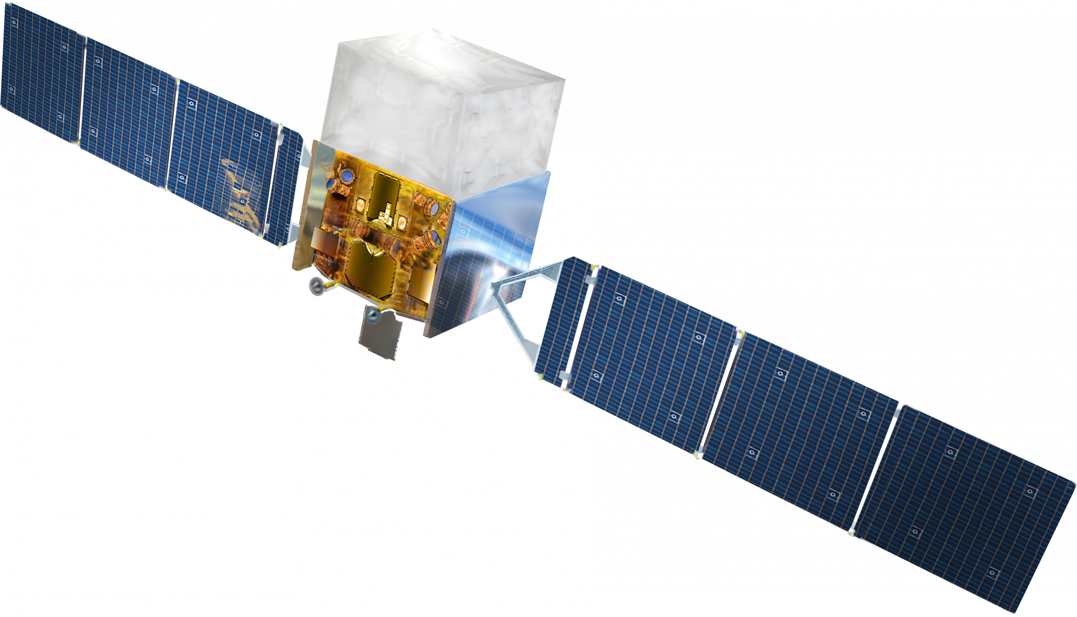
How am I going to do this?
I would use data sets made public by NASA from the Fermi telescope, their gamma telescope.
The lovely algorithm used to find the recent picture of a black hole worked because it used multiple data sets in order to minimize error. I would use a similar technique.
I would have to use an unsupervised algorithm as there isn’t any truly conclusive prior information on my topic.
Image: https://en.wikipedia.org/wiki/Fermi_Gamma-ray_Space_Telescope

Slide 7
Questions?

Slide 8
Image citations
Abell, T. & Kaehler, R. (2017, October 31). Astronomy Picture of the Day. Retrieved from https://apod.nasa.gov/apod/ap171031.html.
Fermi Gamma-ray Space Telescope. (n.d.). Retrieved from https://en.wikipedia.org/wiki/Fermi_Gamma-ray_Space_Telescope.
Hooper, D., & Goodenough, L. (2011). Dark matter annihilation in the Galactic Center as seen by the Fermi Gamma Ray Space Telescope. Physics Letters B,697(5), 412-428. doi:10.1016/j.physletb.2011.02.029

